Slide 1

MUSIC RECOMMENDER SYSTEM USING - MACHINE LEARNING
- JS MOHAMMED HAFEEZ
21WU0101015

Slide 2
Abstract
In my project, I will be using a sample data set of songs to find correlations between users and songs so that a new song will be recommended to them based on the users which select a song from a dropdown menu and click a button to see recommendations.
I will implement this project using libraries like Numpy, Pandas, NLTK, Scikit-Learn, Pickel, OS, etc.
I will also be using Cosine similarity along with TfidVectorizer.
Along with this, a front end with Streamlit and Spotipy that will show us the recommended songs when a specific song is processed.

Slide 3
Introduction
A Music Recommender System will learn from the user which select a song from a dropdown menu and click a button to see recommendations.
By using this system, the music provider will predict and then offer the appropriate songs to their user based on their interest of search.
The primary goal is to enhance user experience by suggesting songs or artists that are likely to match the user's preferences.

Slide 4
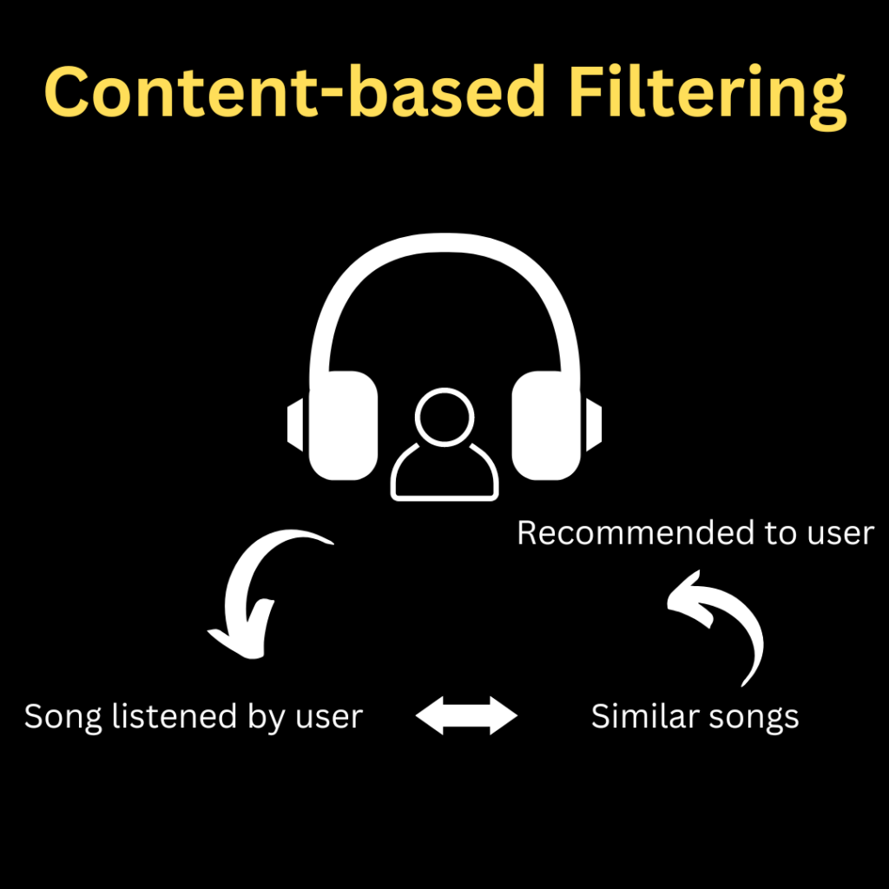
Domain
The main domain of a Music Recommender System using machine learning is typically within the broader field of Recommender Systems or Recommendation Engines. In the context of music, this falls under the domain of Music Information Retrieval (MIR) and Music Data Mining.

Slide 5
Problem Statement
Design and implement a Music Recommender System that leverages machine learning techniques to provide personalized music recommendations to users based on their preferences and behavior.
The system should analyze user interactions, such as listening history and preferences, and utilize content-based and collaborative filtering methods to generate accurate and diverse music suggestions.
The system should be deployed as a user-friendly web application, allowing users to easily explore and enjoy the recommended music.

Slide 6
Objectives
Enhance User Experience
Sub-objectives:
Provide personalized music recommendations.
Increase user engagement and satisfaction.
2. Improve Music Discovery
Sub-objectives:
Introduce users to new and diverse music.
Facilitate the exploration of different genres and artists.
3. Utilize Machine Learning Techniques
Sub-objectives:
Implement collaborative filtering algorithms.
Leverage content-based filtering for accurate recommendations.
Explore hybrid models for a comprehensive approach.

Slide 7
Objectives Continued…
4. Address the Cold Start Problem
Sub-objectives:
Provide meaningful recommendations for new users.
Handle situations where songs have limited interaction data.
5. Ensure System Scalability
Sub-objectives:
Maintain effectiveness as the user and song databases grow.
Optimize system performance for responsiveness.
6. Incorporate User A Preferences
Sub-objectives:
Analyze user behaviour, likes, and dislikes.
Allow user input for preferences and feedback.

Slide 8
Implementation
Start
Data Collection
Data Preprocessing
Feature Extraction
User Interface
Similarity Calculation
End

Slide 9
References
Varsha Verma, Ninad Marathe, Parth Sanghavi, Dr. Prashant Nitnaware Department of Information Technology, PCE, Navi Mumbai, Maharashtra, India.Link: (PDF) Music Recommendation System Using Machine Learning (researchgate.net)
Luo Zhenghua, “Realization of Individualized Recommendation System on Books Sale,” IEEE 2012 International Conference on Management of e-Commerce and e-Government. pp.10-13.

Slide 10
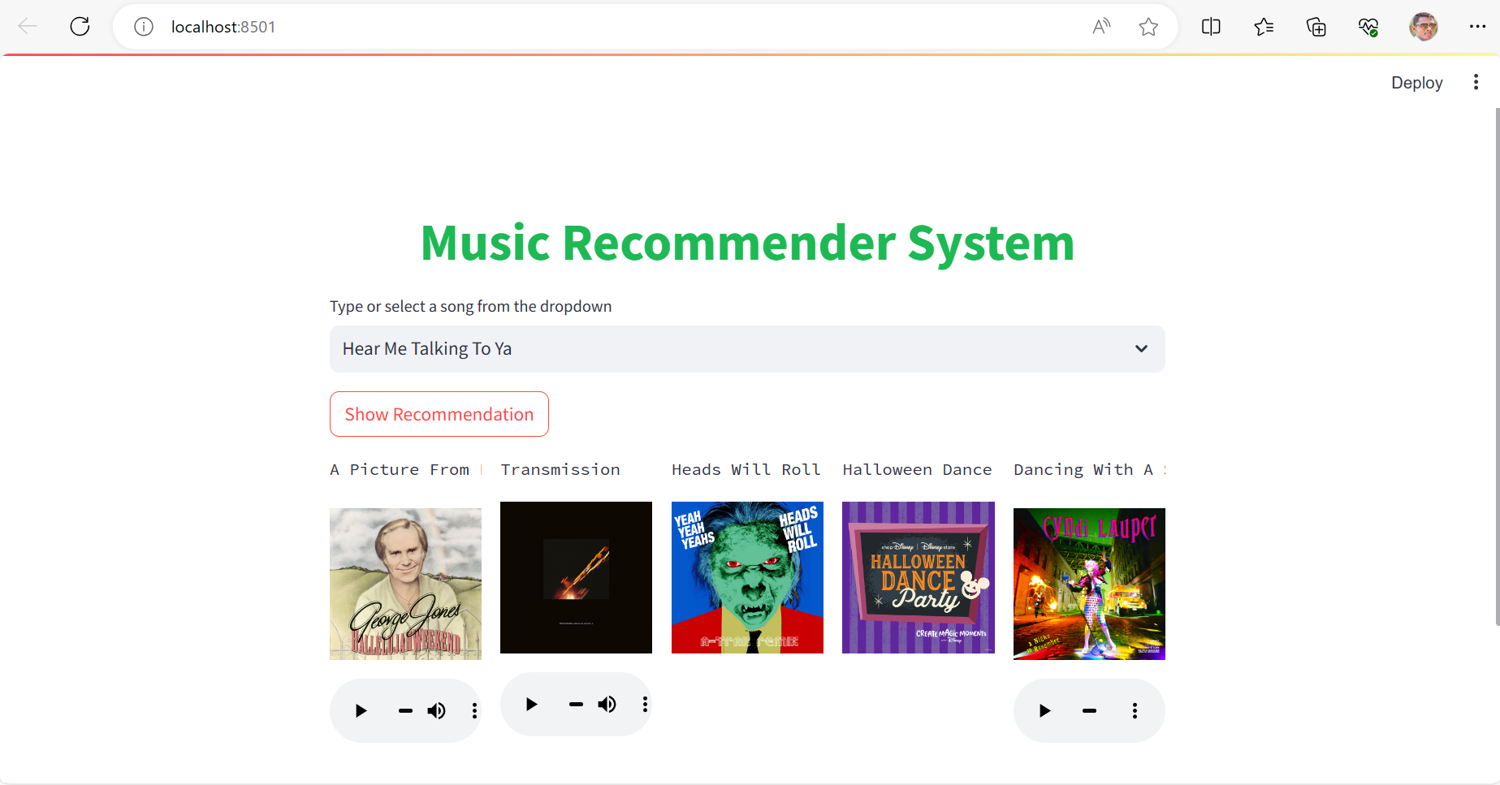
Result

